Slide 1
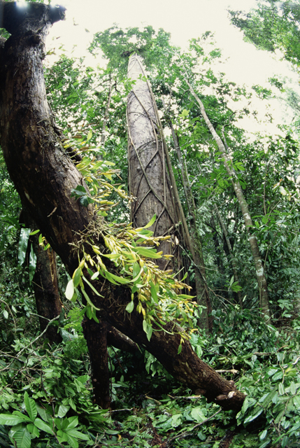
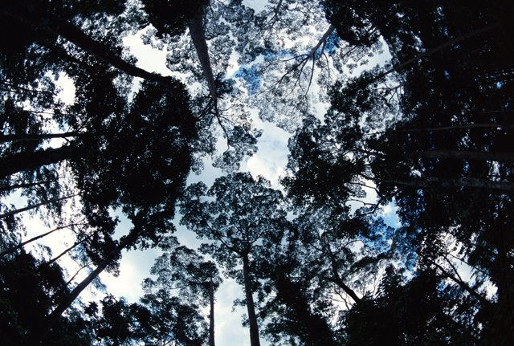
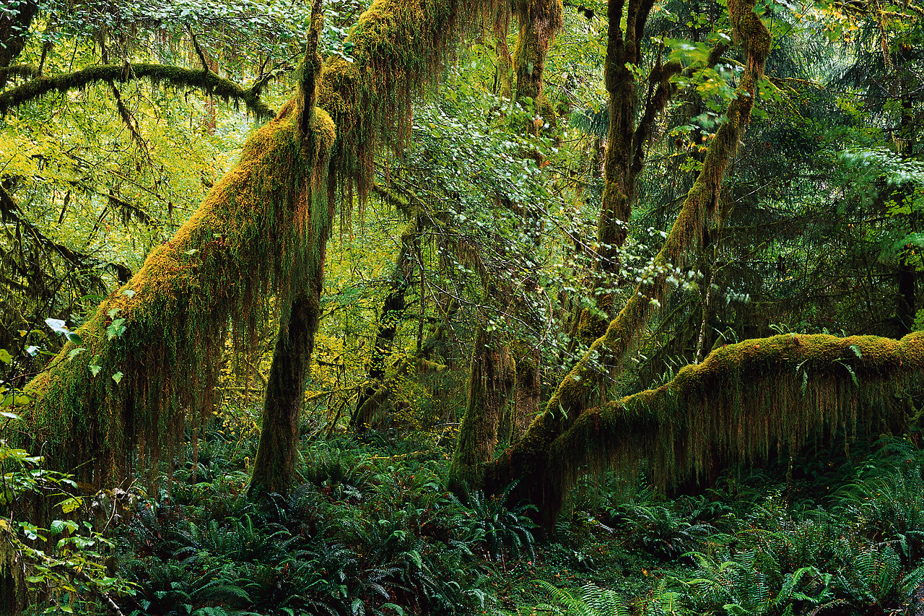
An Invitation

Slide 2
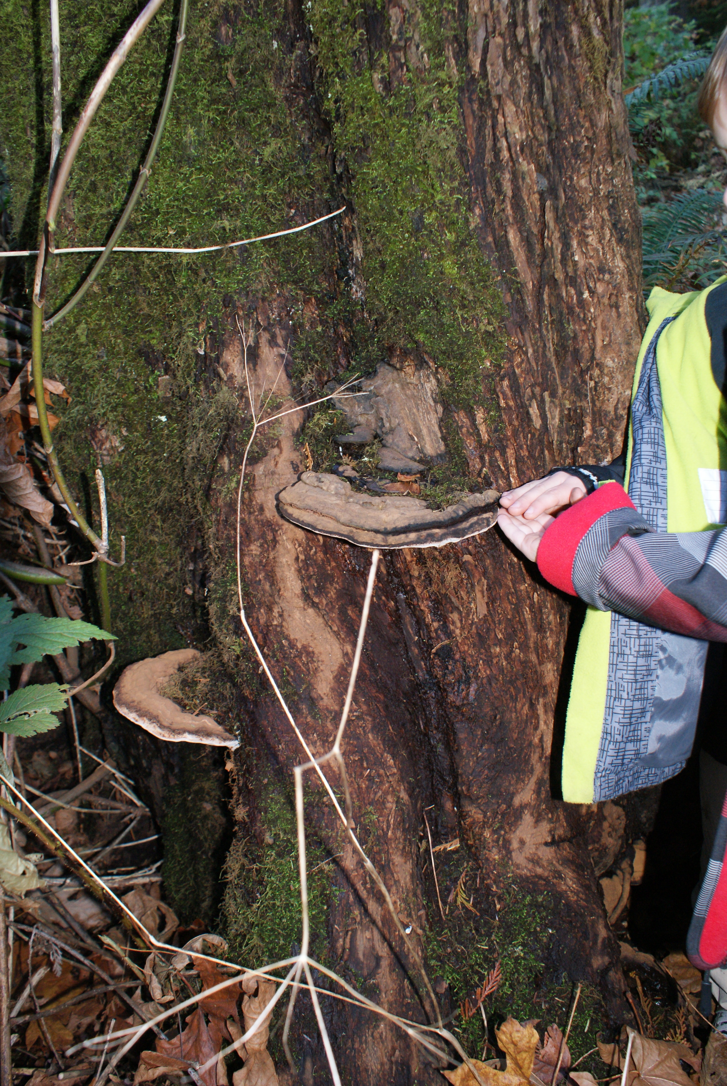
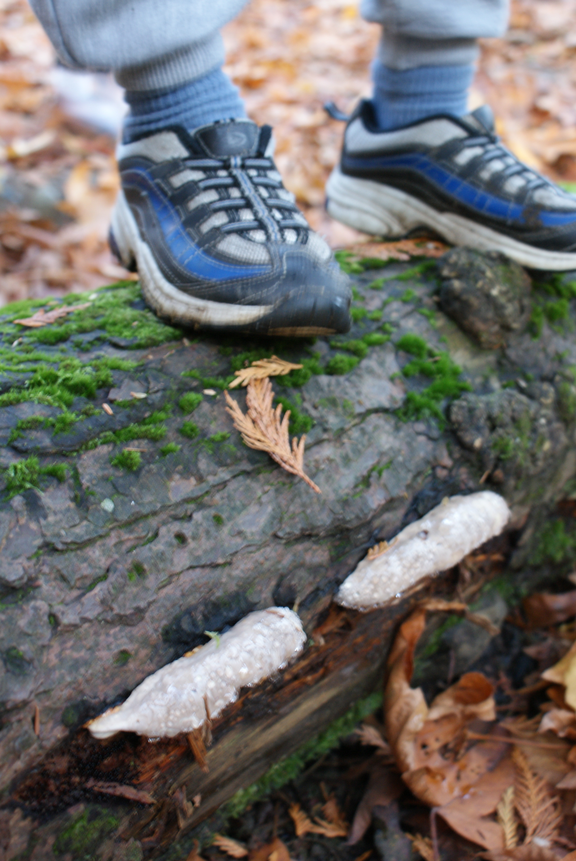
Notes:
This familiar setting – our temperate rainforest - invites physical, emotional and intellectual engagement; opportunity to use children's natural curiosity and propensity for posing questions to guide you. In an old growth forest everything is connected... this understanding guides us to...

